Slide 1
CASE STUDY-BANKING CREDIT CARD SPEND PREDICTION & IDENTIFY DRIVERS FOR SPEND

Slide 2
Agenda
Business context, goal and approach
Data understanding
Exploratory Analysis
Data audit and preparation
Univariate Analysis
Bivariate Analysis
Normality Assumption
Feature Engineering
Model building and execution
Model comparison
Residual Plots, Decile Analysis
Key Drivers
Predict on new data

Slide 3
Business problem
Business Context:
One of the global banks would like to understand what factors driving credit card spend are. The bank want use these insights to calculate credit limit. In order to solve the problem, the bank conducted survey of 5000 customers and collected data.
Business Goals:
The objective of this case study is to understand what's driving the total spend (Primary Card + Secondary card). Given the factors, predict credit limit for the new applicants.
Approach:
Analyse relationship of all independent variables with primary and secondary credit card spend.
Use regression and ML techniques to analyse and predict spent and arrive at a credit limit.

Slide 4
Data understanding
Data has been provided for 5000 customers.
Detailed data dictionary has also been provided for understanding different variables in the data.
Some of the data is already encoded in the numerical format to reduce the size of the data, however some of the variables are categorical.
Total number of columns in the data set are 130. 84 categorical variables and 46 numerical variables.
Data types of the variables are: float64(31), int64(97), object(2)
There is no Total Spent feature in the data for us to predict but it has cardspent and card2spent information. We can use these for our total spent analysis and prediction.
Customer Id (custid) is the unique row level identifier for the data.
Birth Month (birthmonth) is another variable providing personal customer information.
carditems and card2items variables are listed in the data dictionary but are not available in the actual data.

Slide 5
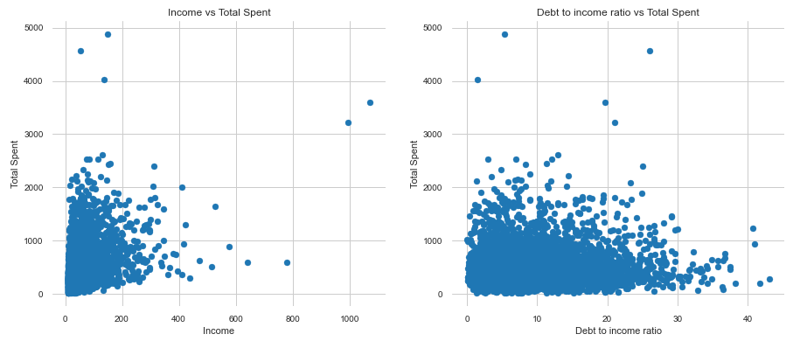
Exploratory Analysis
Total Spend shows some dependent variation with income and debt to income ratio.

Slide 6
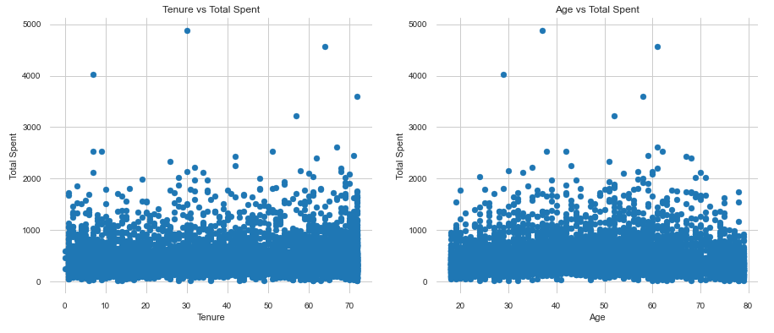
Exploratory Analysis
Total Spend does not show much dependent variation with tenure(number of months with service) and age.

Slide 7
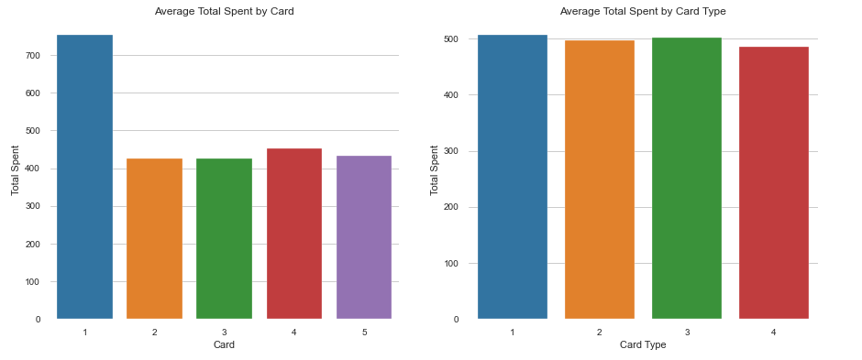
Exploratory Analysis
Card 1 (American Express) shows the most average spend by some margin.
All card types are very close to each other. Card Type 1, designation of primary credit card as none, not holding either gold or platinum card shows maximum spend. But, in single largest card type category, platinum shows maximum spend.

Slide 8
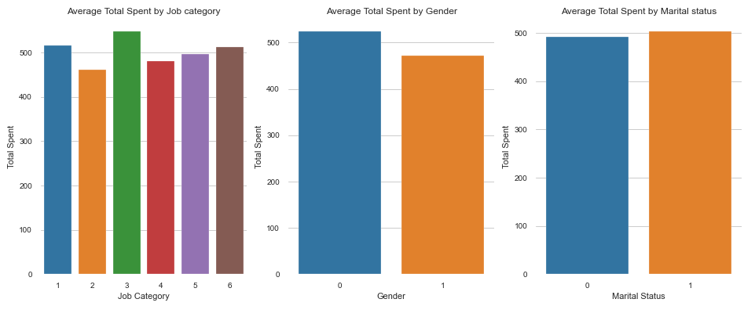
Exploratory Analysis
People with job category, Managerial and Professional, show the maximum average spend followed by service category.
Males are spending slightly higher than females.
Married customers are spending slightly higher than unmarried customers.

Slide 9
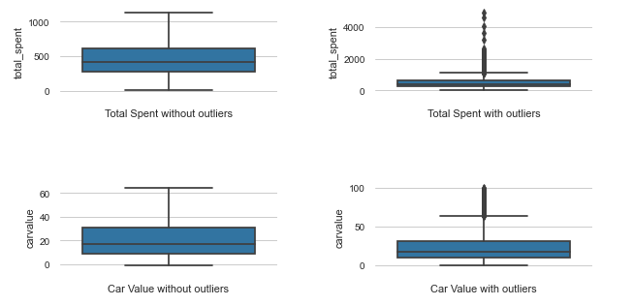
Exploratory Analysis
Looking at some of the numerical variables, both total_spend and carvalue have outliers. They both seem to be left skewed. We may have to perform some transformations.

Slide 10
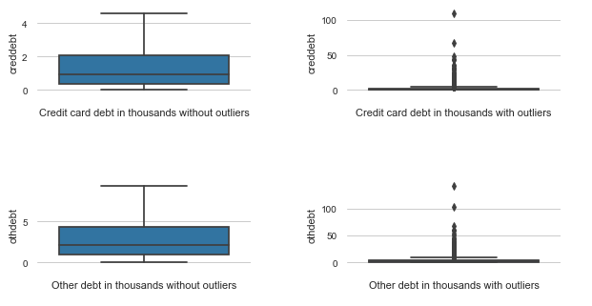
Exploratory Analysis
Looking at some of the numerical variables, both creddebt and othdebt are highly skewed. We may have to perform some transformations.

Slide 11
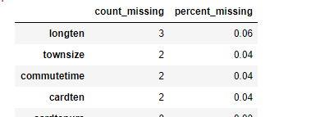
Data audit and preparation
Renaming columns appropriately – no name change is required
Check data types - Done
Check for missing values – Done
Following variables have missing greater than 25%, these were dropped.
'lntollmon','lntollten','lnequipmon','lnequipten','lncardmon','lncardten','lnwiremon','lnwireten’
longten, commutetime, cardten would be imputed with mean.
townsize would be imputed with mode.
Check for duplicates – no duplicates found
Any type conversion required - not required
Any special characters that need to removed/replaced – no special characters

Slide 12
Data audit and preparation
Below variables have a very high number of zeros, probably are not used that much:
pets has 1529 (30.6%) zeros pets_cats has 3413 (68.3%) zeros
pets_dogs has 3762 (75.2%) zeros pets_birds has 4698 (94.0%) zeros
pets_reptiles has 4818 (96.4%) zeros pets_small has 4749 (95.0%) zeros
pets_saltfish has 4942 (98.8%) zeros pets_freshfish has 3462 (69.2%) zeros
8. 'custid','birthmonth’ were dropped as they were unique customer personal information.
Our Y variable or target variable was created by cardspent, card2spent and these were subsequently dropped.
'total_spent’] = 'cardspent’ + 'card2spent’
Following were dropped as they have been created with log transformation of the original variable. We can do are own transformations, if required.
'lninc','lncreddebt','lnothdebt','lnlongmon','lnlongten’
Dropped the below category variables as these are derived from the respective numerical variables.
'agecat','edcat','empcat','inccat','spousedcat','addresscat','cardtenurecat','card2tenurecat’
Dropped ‘commute’ and ‘commutecat’ as the data in these variables is captured in the following variables:
commutecar, commutemotorcycle, commutecarpool, commutebus, commuterail, commutepublic, commutebike, commutewalk, commutenonmotor, telecommute
Looking at the data dictionary, some of the values for NA, these we would treat as missing and would impute.
If carown, cartype, carcatvalue, carbought have the value as -1, we would impute with mode.
If ‘reason’ variable has a value of 8 then we would impute it with mode.

Slide 13
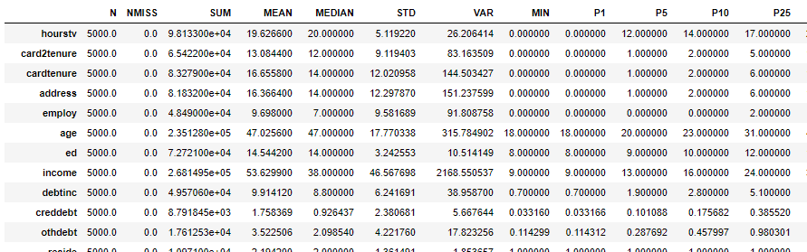
Data audit and preparation
Splitting the data into numerical and categorical variables, there were 33 numerical and 71 categorical variables.
Check for Outliers – Done
Values below 1 percentile and above 99 percentile were dropped.
Based on high correlation between X numerical variables, following were dropped:
'tenure', 'card2tenure','address', 'employ','pets_freshfish', 'longmon', 'tollmon', 'equipmon', 'wiremon', 'cardmon’, 'wiremon’
Based on importance of categorical variables after ANNOVA test, 32 categorical variables were dropped.
One hot encoding for categorical variables was done.
Calculating CV for all the variables, all variables had CV > 0.05, none were dropped.
Tried log(x+1), square, sqrt, exp transformations on the variables to see which transformation gives us the highest correlation. But, transformations only increased the correlations by insignificant level.

Slide 14
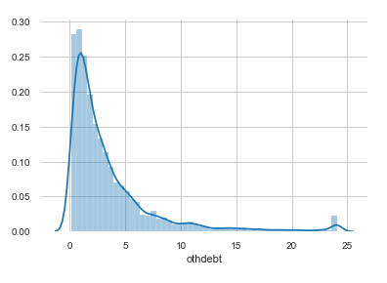
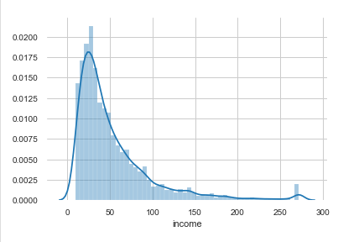
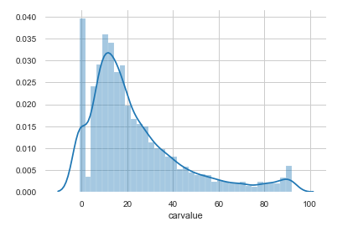
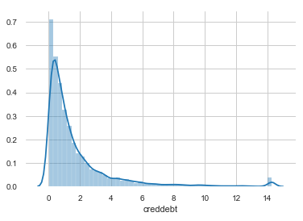
Univariate Analysis
Looking at the distributions of numerical variables, almost all variables are skewed.

Slide 15
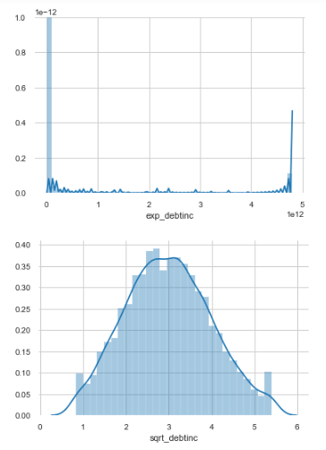
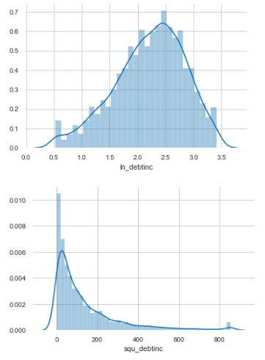
Univariate Analysis
Tried log(x+1), square, sqrt, exp transformations on the variables to see which transformation gives us the highest correlation. But, transformations only increased the correlations by insignificant level. Some transformation did improve the distribution.

Slide 16
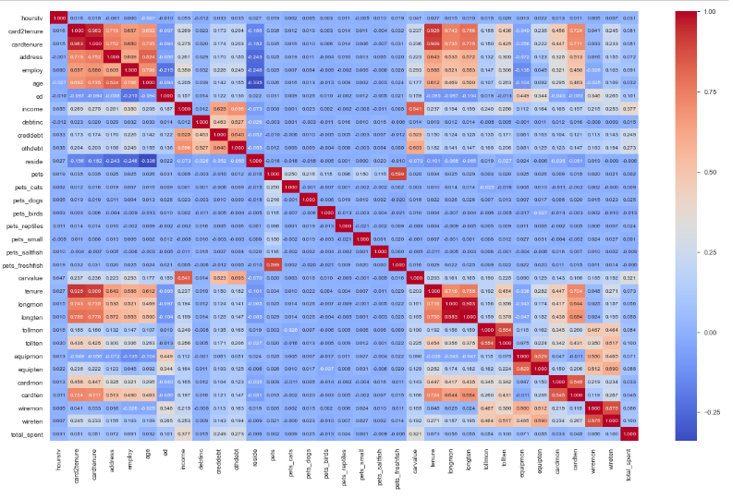
Bivariate Analysis
Based on the correlation matrix below are the features which are highly correlated.
pets_freshfish and pets
longmon and longten
tollmon and tollten
equipmon and equipten
cardmon and cardten
wiremon and wireten
card2tenure, cardtenure and tenure
address, employ and age
Out of these we would drop some of the variables for model building.

Slide 17
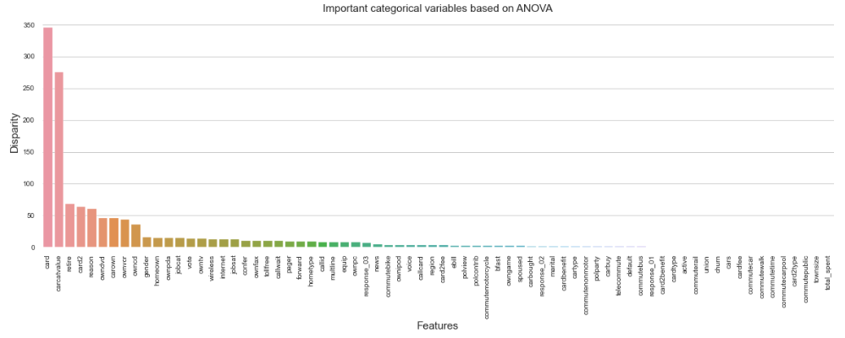
Bivariate Analysis
Based on the ANOVA test between categorical variables – card, carcatvalue, retire, card2 and reason are the top 5 variables.

Slide 18
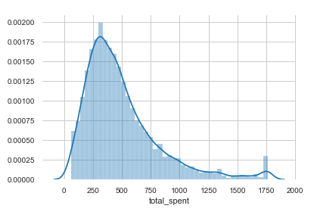
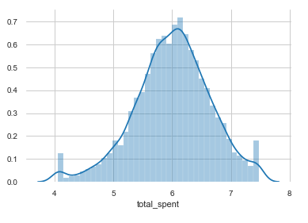
Normality Assumption
Target variable should have a normal distribution for better prediction with ML. But, looking at the total_spent distribution, it is skewed left due to outliers in the data. We performed log transformation on total_spent to convert it to a normal distribution.
Y variable without transformation
Y variable with log transformation

Slide 19
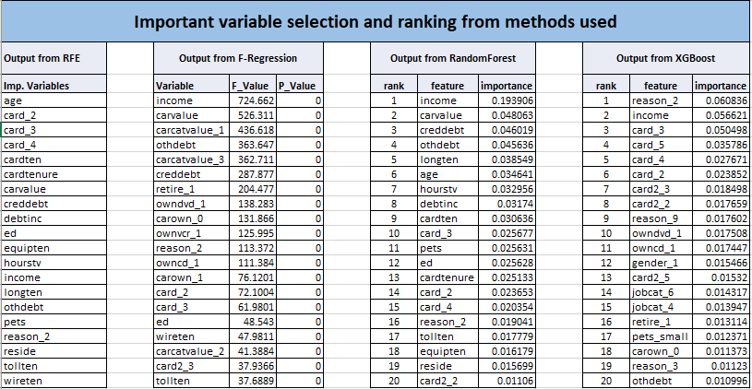
Feature Engineering
We used Recursive Feature Elimination, univariate F-regression, RandomForest Regressor and XGBoost Regressor to come up with the most important variables.

Slide 20
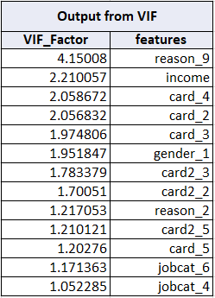
Feature Engineering
The features were further reduced with Variable Inflation Factor technique.
The feature list individually with VIF was tried.
Combination of feature list from different techniques with VIF was tried.
Examples:
RF + RFE -> VIF
RF + RFE + F-reg -> VIF
RF + RFE + XGBoost + F-reg -> VIF
RFE + XGBoost -> VIF etc.
Here is the optimal output from VIF

Slide 21
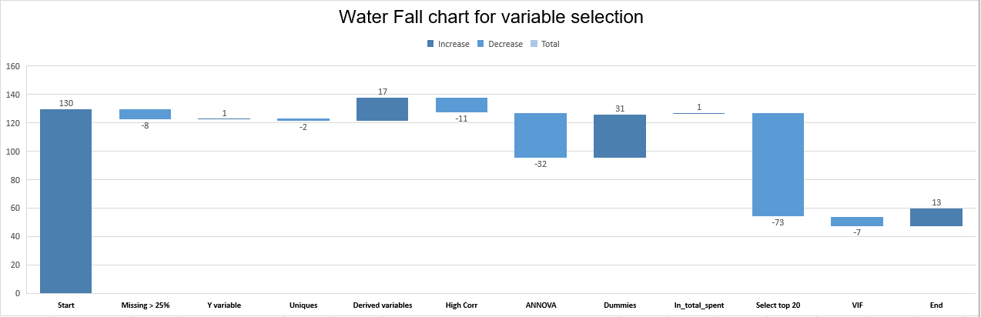
Feature Engineering
Imported data had 130 features
Dropped featires missing more than 25%
Created target Variable
Dropped unique + personal features
Dropped derived variables
Dropped some features which had high correlation betweeen them
Categorical features dropped based on Annova test
Create dummies
Log transformation for Y
Selected 20 from various techniques
VIF to reduce further, we were left with 13 variables

Slide 22
Model building and execution
Below models were tried:
OLS Regression
Random Forest regression
Xtreme Gradient Boost regression
Support Vector Machines (SVR)
Train data(train.csv) was further split into train and test. Model was built on train and validating on test before actual prediction.
Test to Train split was 30% and 70% .
4 techniques - statsmodels ols, XGBRegressor, SVR, RandomForestRegressor were used and compared against R2 score, MAPE and RMSE.
Using ANN with GridSearchCV or KNN with GridSearchCV, even with 80 to 120 models caused the machine to hang or run on for hours (ultimately the process was killed).
Model was validated with error distribution analysis and decile analysis.
5-fold cross validation was performed as part of GridDearchCV

Slide 23
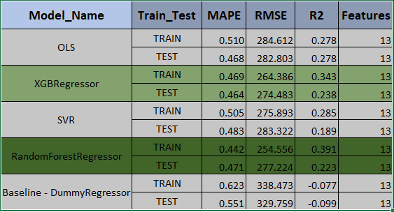
Model comparison
Final Model:
RandomForestRegressor is our top and final model as it does better in terms of R2 score and error metric even though OLS has the least overfitting issue.
Best Parameters for the models:
OLS: default
RandomForestRegressor:
'max_depth': 8, 'max_features': 7, 'n_estimators': 70, bootstrap: True, CV: 5
XGBRegressor:
'learning_rate': 0.03, 'max_depth': 3, 'n_estimators': 450
, n_jobs: -1, CV: 5
SVR:
'C': 7, 'gamma': 0.002, 'kernel': 'rbf’, n_jobs: -1, CV: 5

Slide 24
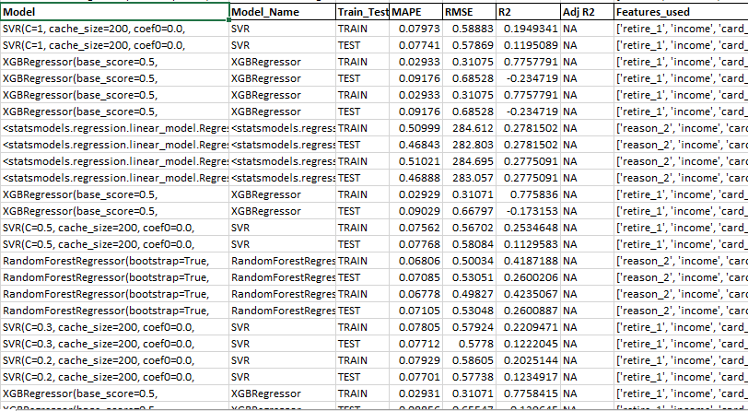
Model comparison
Some of the models that were tried with different parameters.

Slide 25
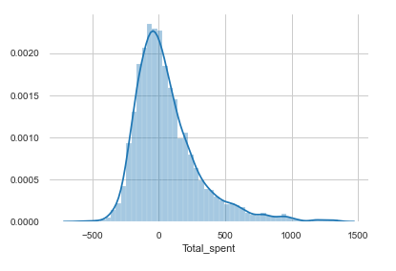
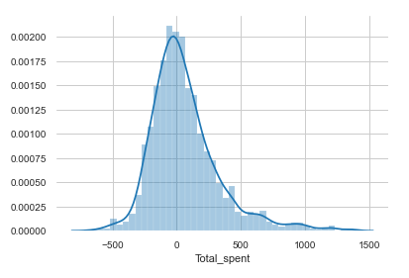
Residual Plots
Residual plots for both train and test follow normal distribution
Train Errors
Test Errors

Slide 26
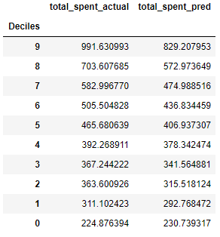
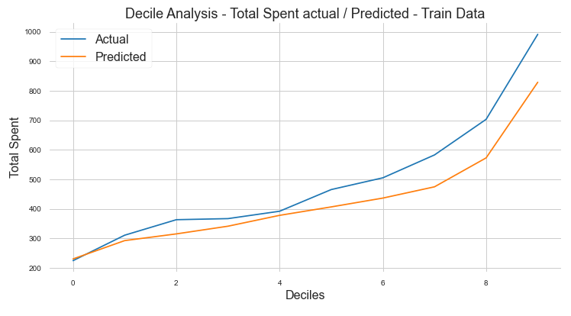
Decile Analysis
Train Data

Slide 27
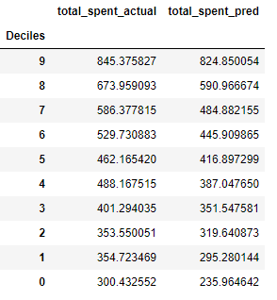
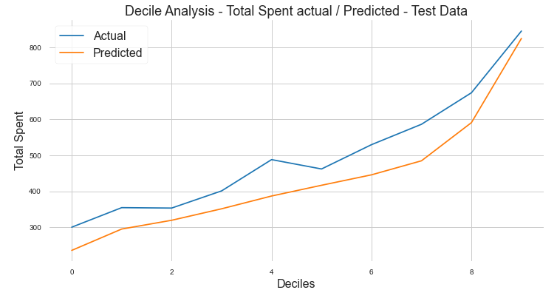
Decile Analysis
Test Data

Slide 28
Key Drivers
Our top key drivers for credit limit prediction are:
Reason - If the Primary reason for being a customer is Convenience (Reason category 2), they would be preferred.
Income – this is the primary drivers and customers with higher income would be preferred to have a higher credit limit.
Gender – Male customers have a slight edge over the female customers.
Card – Customers have American Express cards would be prefeed and a higher limit allocated. American Express card holders have almost double the total spend than any other card holder.
A credit limit, 3 times the predicted total spend can be allocated to the customer.

Slide 29
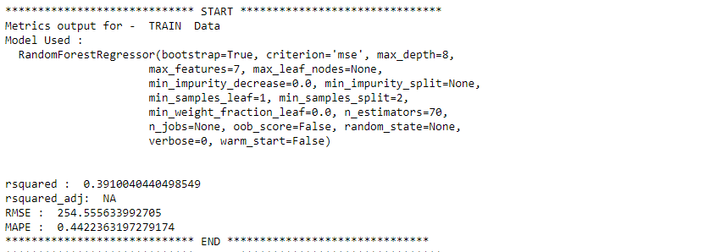
Predict on new data
For prediction on new data:
All data manipulation steps would apply as in this case study including missing treatment and outlier treatment.
All derived variable would need to be created.
All dummy variable creation steps would apply.
Test data would contain the finalized list of variables after the variable reduction steps.
Total_spent would be predicted using the finalized RandomForestRegressor
Final models saved into pickle object would used.

Slide 30
Thank You !

